Slide 1
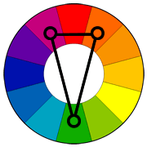
Complementary Colors- 2 colors that are directly across each other from the color wheel, ex- red & green
Triadic Colors- 3 colors that are evenly spaced around the color wheel, ex- purple, orange & green
Analogous colors- Colors that are next to each other on the color wheel, ex- red orange, orange, yellow orange
Split-complementary colors- Two colors that are next to a color's complement, ex- green, red violet & red orange
Cool colors- Purples, blues & greens
Warm colors- Reds, oranges & yellows
Monochromatic- Mainly one color, including that color's tints and shades
Tint- Adding white to a color to make it lighter
Shade- adding black to a color to make it darker

