Slide 1
Notan Design

Slide 2
Open file
Open the Notan.PSD
Go through photoshop, file > open
Goodies > Course folders > Art > Digital Palette > Notan.psd
If you see a grid, click View > Uncheck “extras”
  Or hit “control H”

Slide 3
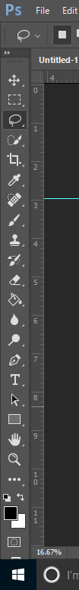
Lasso Tool
Click on the lasso tool
  (Or polygonal lasso)

Slide 4

Lasso/polygonal lasso tool
Click and drag to draw a shape inside the black box
Make sure you do not release the mouse until you come back to where you started at the top

Slide 5
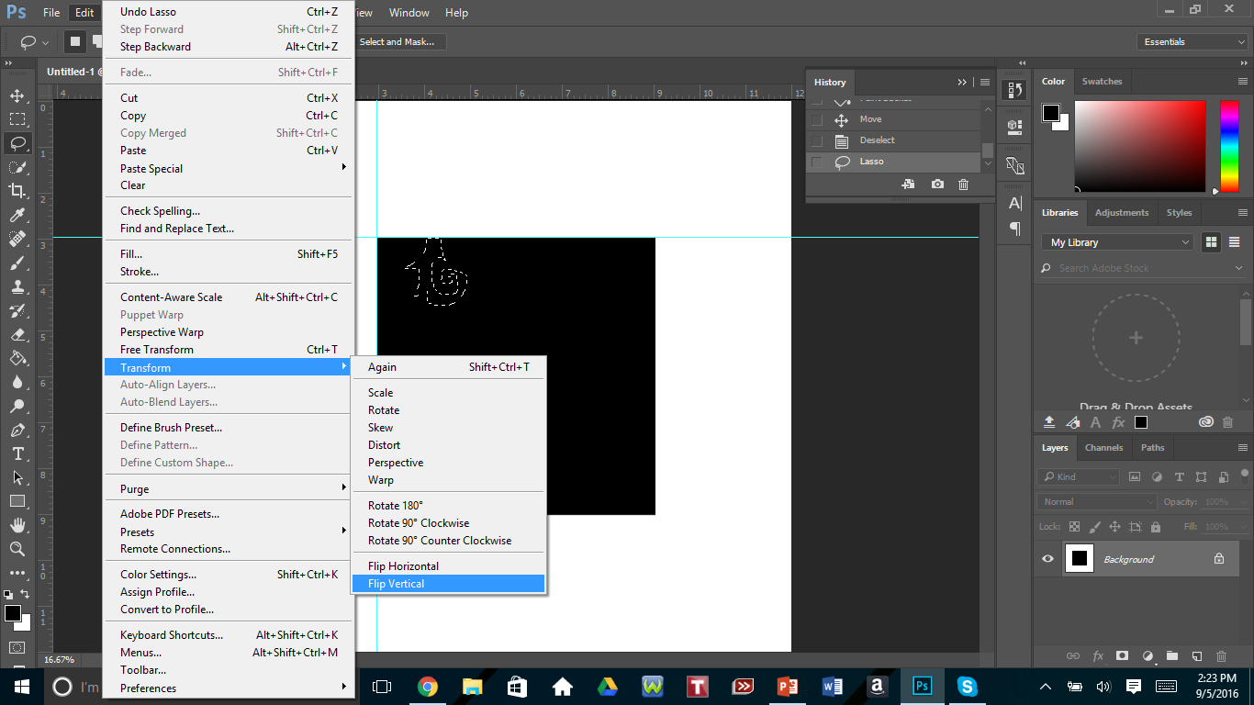
Edit>Transform
Go to Edit > Transform > Flip vertical

Slide 6
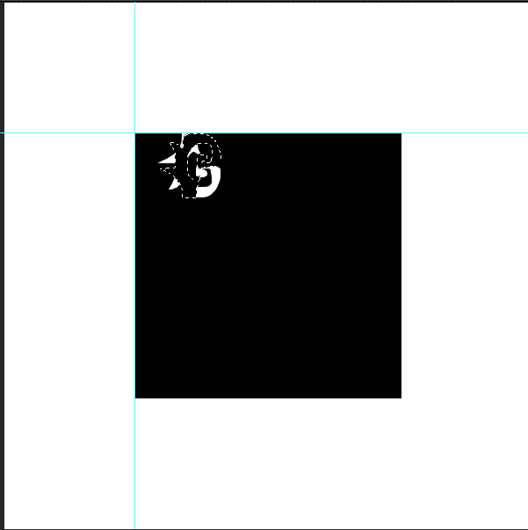
Flip Vertical
Your selection should be flipped vertically

Slide 7
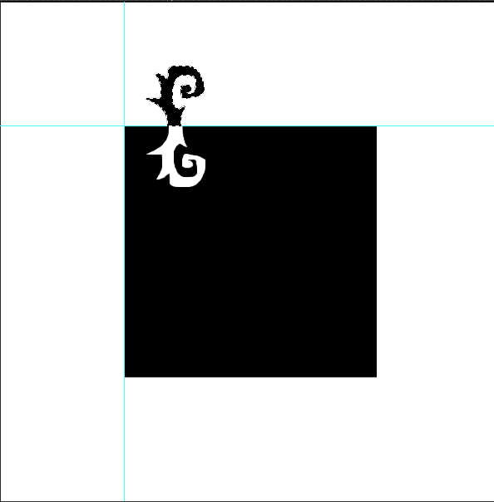
Move it
Click on the move tool
Move your selection to edge of your square
Line it up with the space where you cut it out
Use CTRL + D to deselect

Slide 8

Lasso tool (again!)
Click on the lasso tool
Draw a selection on the side of your black box

Slide 9
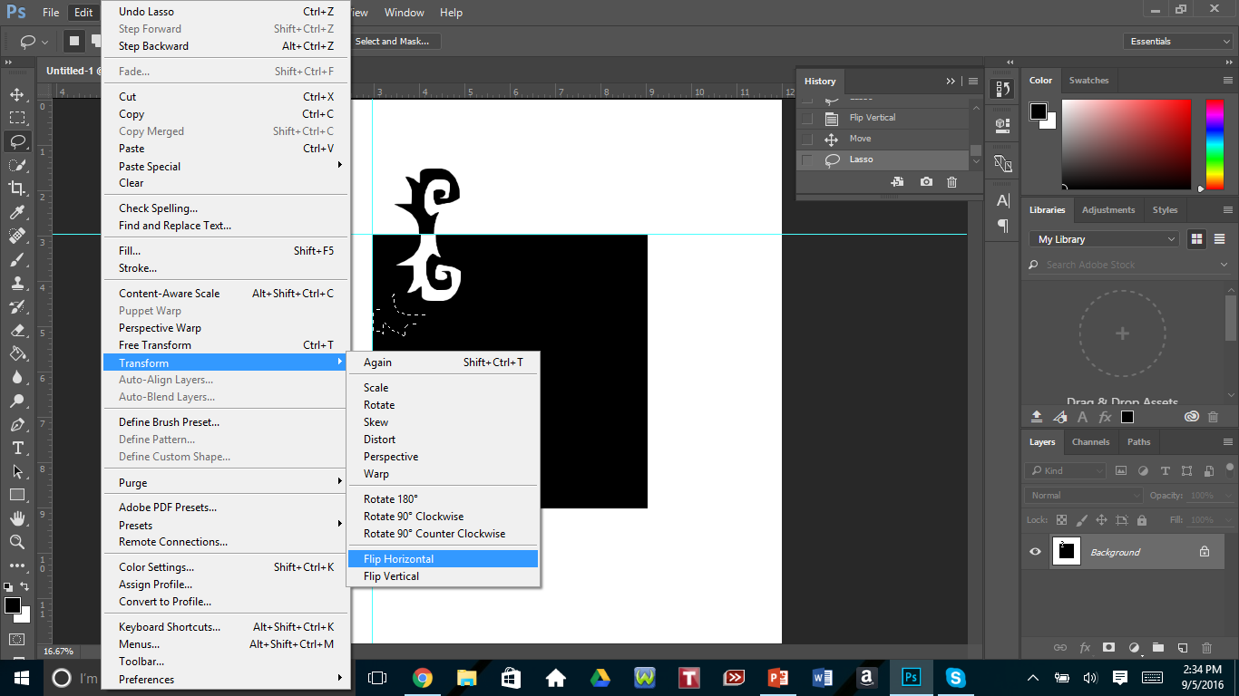
Transform
Go to Edit >Transform>Flip Horizontal
  Shapes on the top & bottom = flip vertical
  Shapes on the left and right = flip horizontal

Slide 10
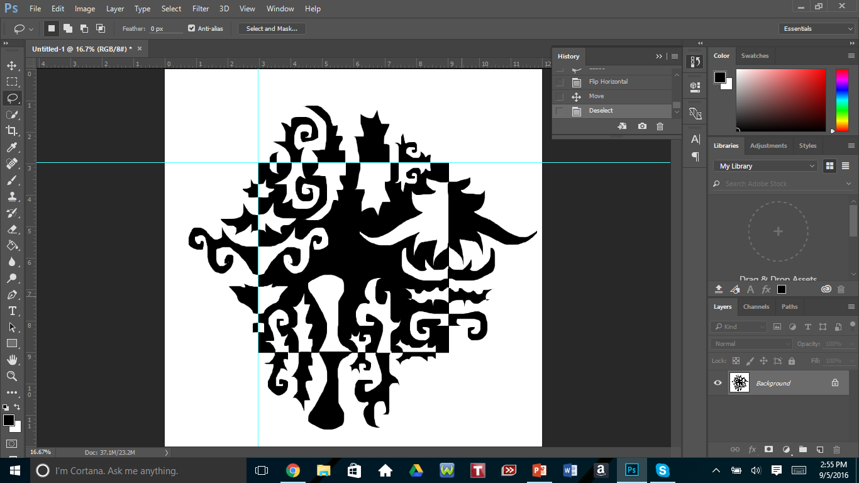
Notan design
Repeat until you have a complete design

