Slide 1
Op Art
Directions

Slide 2
New Document
Make a new document 10x10 inches x 300 resolution
Click view > show > grid
Make a new layer (blank)

Slide 3
Example 1
Use the line tool, change the settings to pixels, and change the weight to 10 from 1

Slide 4
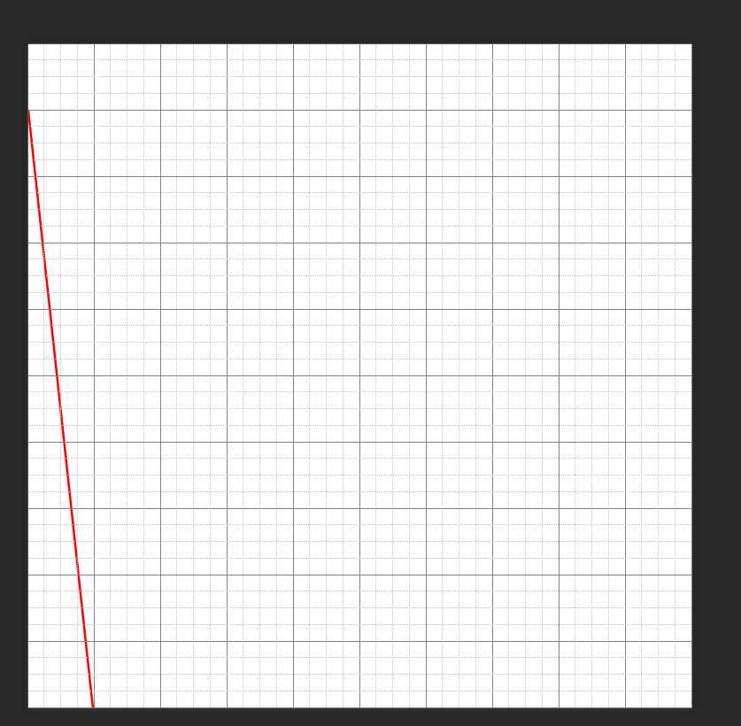
Example 1
Using your line tool draw a line from the first square on the left to the first square at the bottom
You do not have to use red, I am for this example so you can see the lines easier

Slide 5
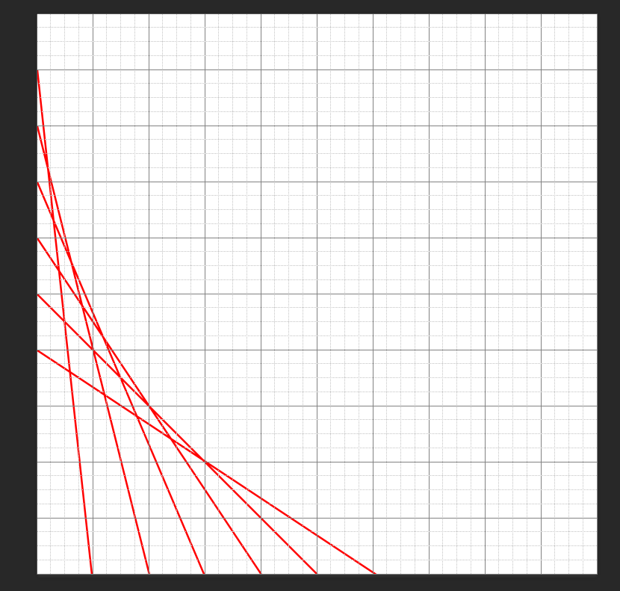
Example 1
Continue from 2 to 2, 3 to 3, etc

Slide 6
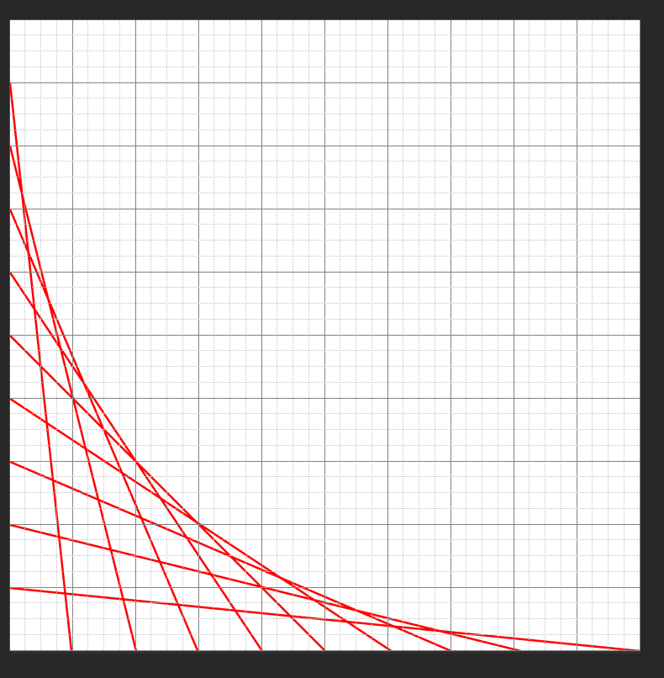
Example 1
Continue all the way from the left to the bottom
Save this and upload to google classroom under “Op Art Example 1”

Slide 7
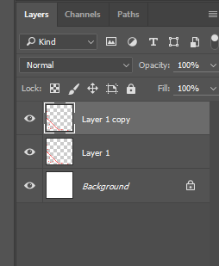
Example 1
Duplicate your layer (right click layer, duplicate)
Hit control T to transform and you will see a menu at the top
Change the angle to -90
Make sure you hit the check when you are done!

Slide 8
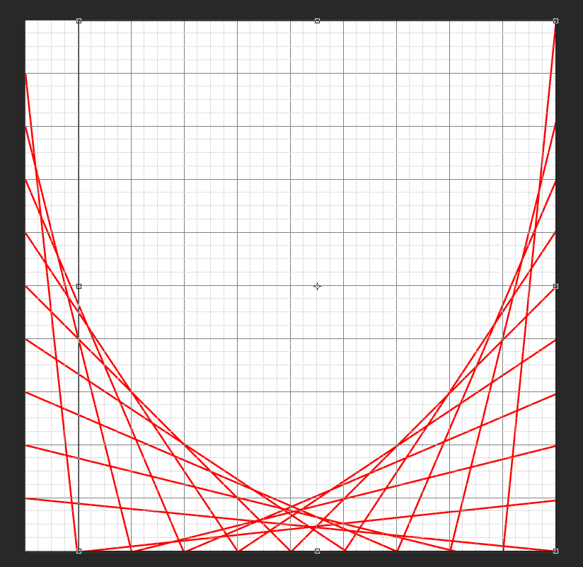
Example 1
Your image will now look like this

Slide 9
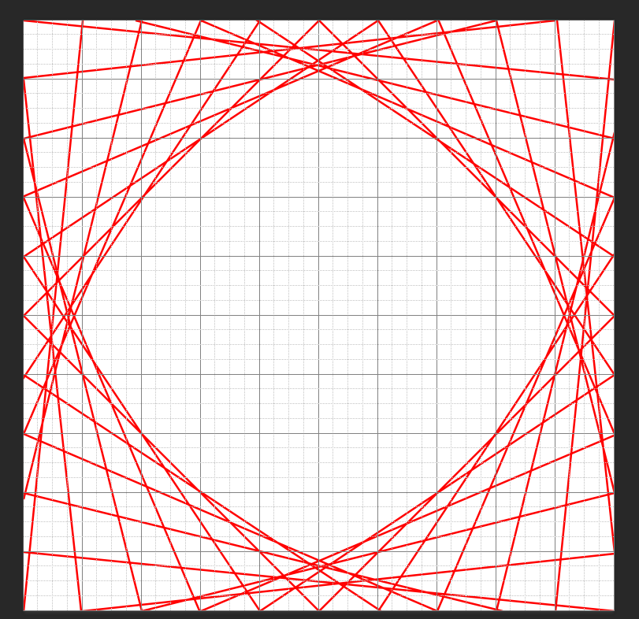
Example 1
Duplicate layer 1 and hit control T
Change the angle to 180 and hit check

Slide 10
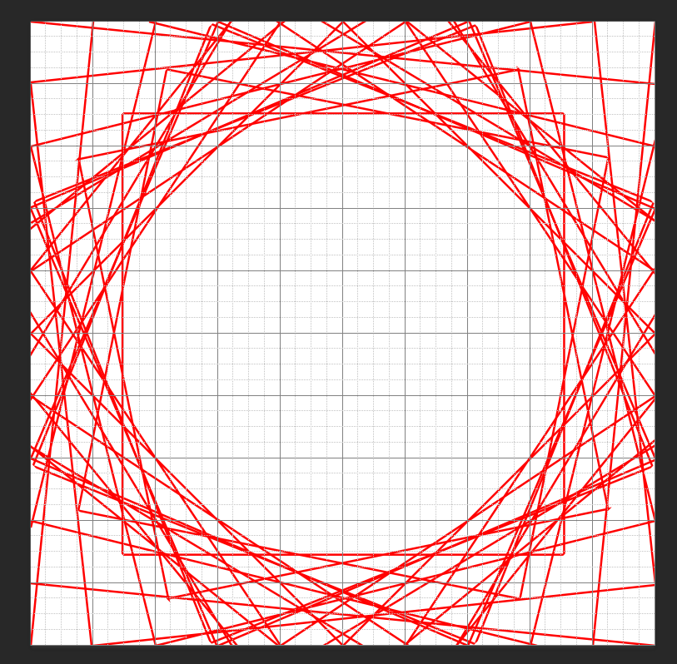
Example 1
Click layer 1 copy and hit merge down
Duplicate the new layer and hit control t
Change the angle to 45
Your new image will look like this
You can also save this version & upload to Google Classroom under Op Art Example 1 as well if you want

Slide 11
Example 2
Create another new document
10x10 inches x 300 resolution
Make sure your grids are showing
Add a new layer

Slide 12
Example 2
Make a line (it should still be on pixels) down the middle horizontally and vertically

Slide 13
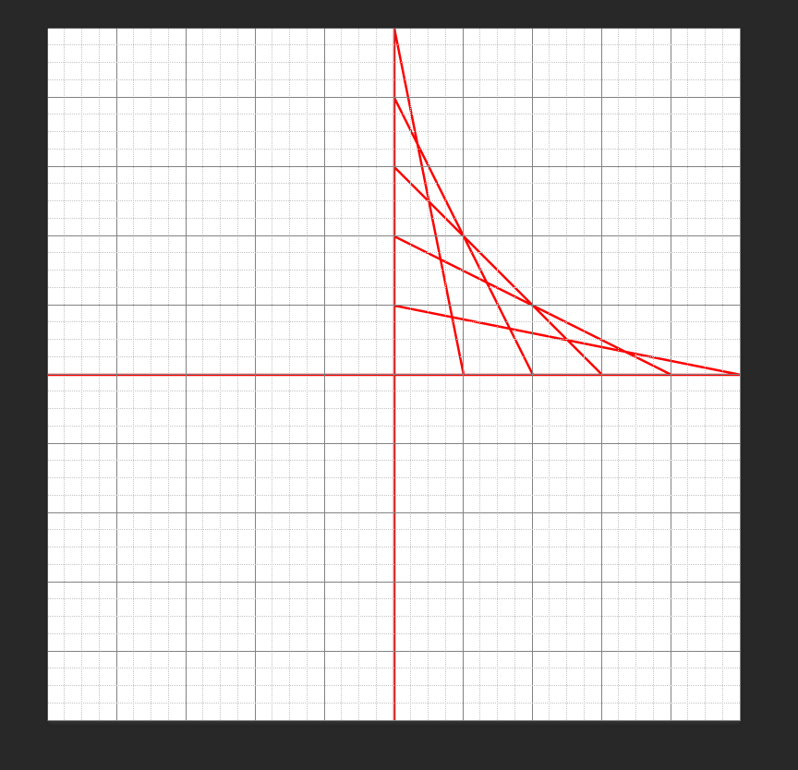
Example 2
Follow the same idea from example 1
In the top right quadrant, go 1 to 1, 2 to 2, etc

Slide 14
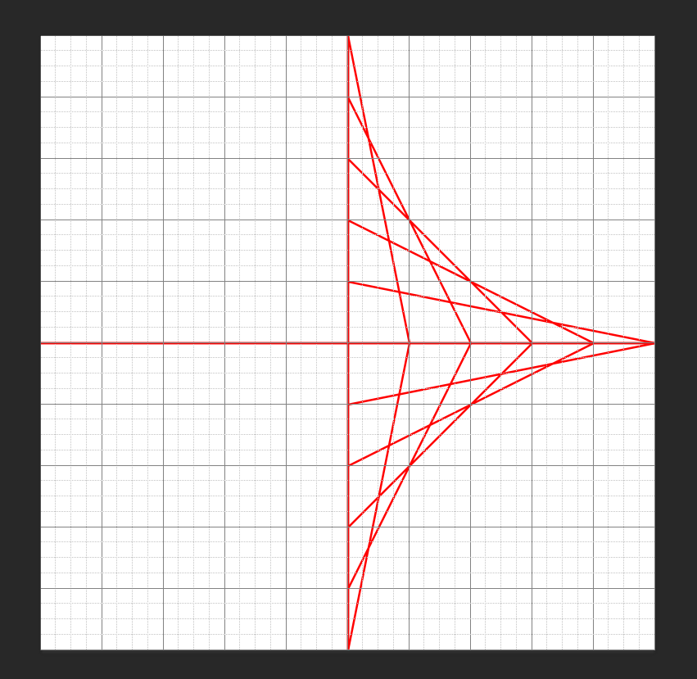
Example 2
Duplicate layer 1, hit control T and change the angle to 90
After you hit the check mark, merge down layer 1 copy to layer 1
This now becomes layer 1 > duplicate layer 1

Slide 15
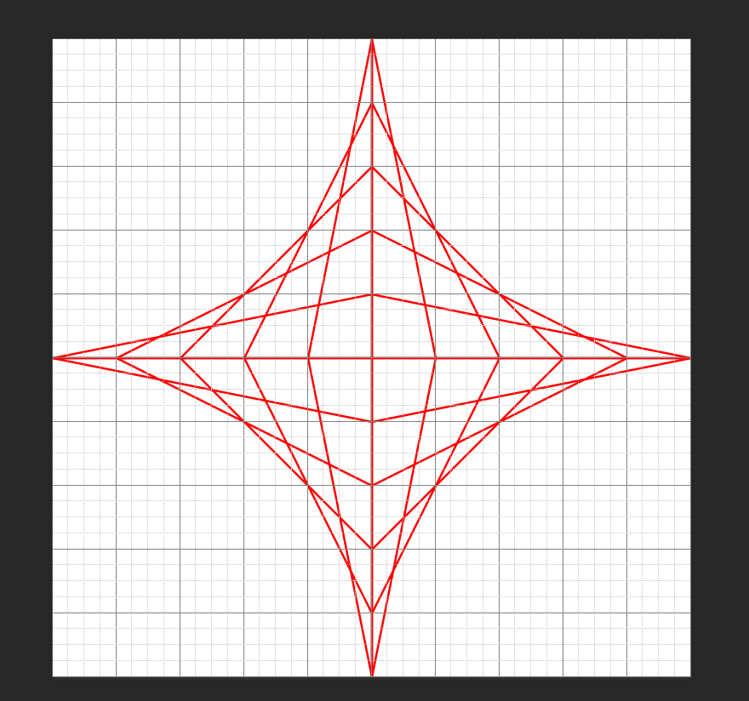
Example 2
Hit control T on layer 1 copy
Change the angle to 180
This is what you will have
Merge down layer 1 copy to layer 1
Save and upload to Google Classroom under Op Art– example 2

Slide 16
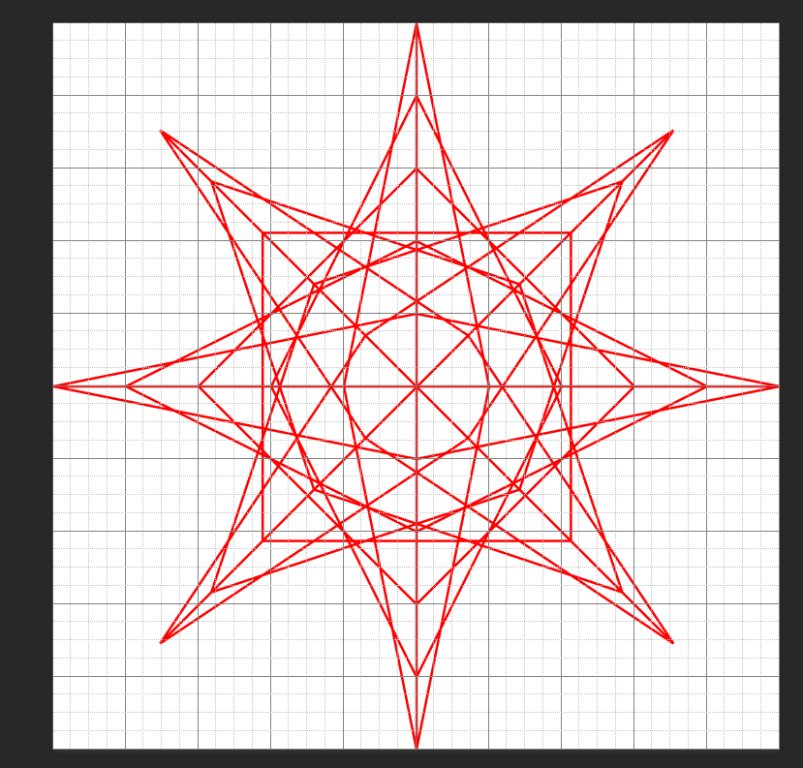
Example 2
Duplicate layer 1 again, hit control T
Change the angle to 45
You can play around with the angles, going halfway each time
EX– 180, 90, 45, 22.5, 11.25
The smaller you go/the more you duplicate the smaller your details will be

Slide 17
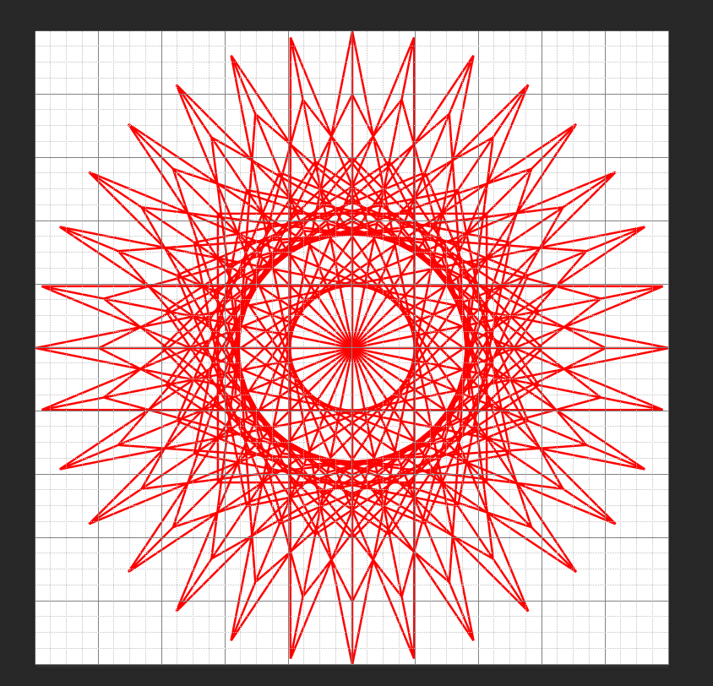
Example 2
This shows the same layers from the last slide being merged, duplicated, then transformed at:
45, 22.5, 11.25 as the angle
Save this and also upload to Op Art— Example 2 in Google Classroom

Slide 18
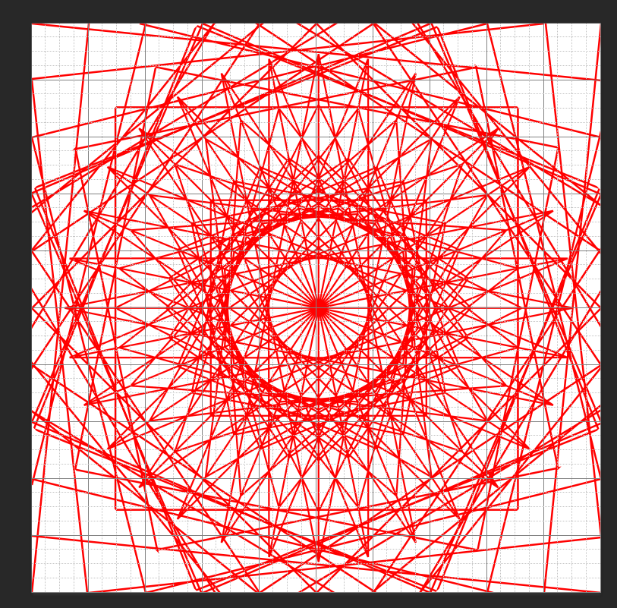
Example 1/2
This is example 1 and 2 combined
Example 2 was re-sized slightly
(control t, then made smaller)

Slide 19
Example 3
Open a new document
10x10 inches, 300 resolution
Make a new layer
Make sure your line tool is set to pixels

Slide 20
Example 3
Draw lines down each box
You can duplicate layer 1 and change the angle to 90 to create a full grid

Slide 21
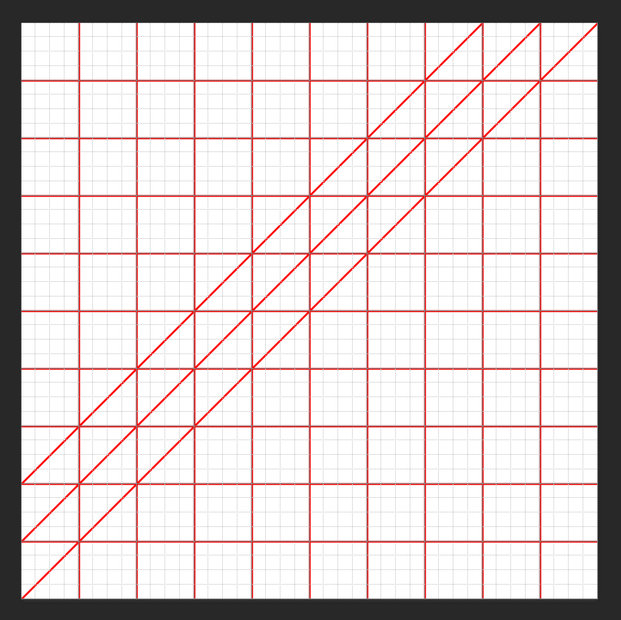
Example 3
Use the line to go through the corners of the box
It will look like this

Slide 22
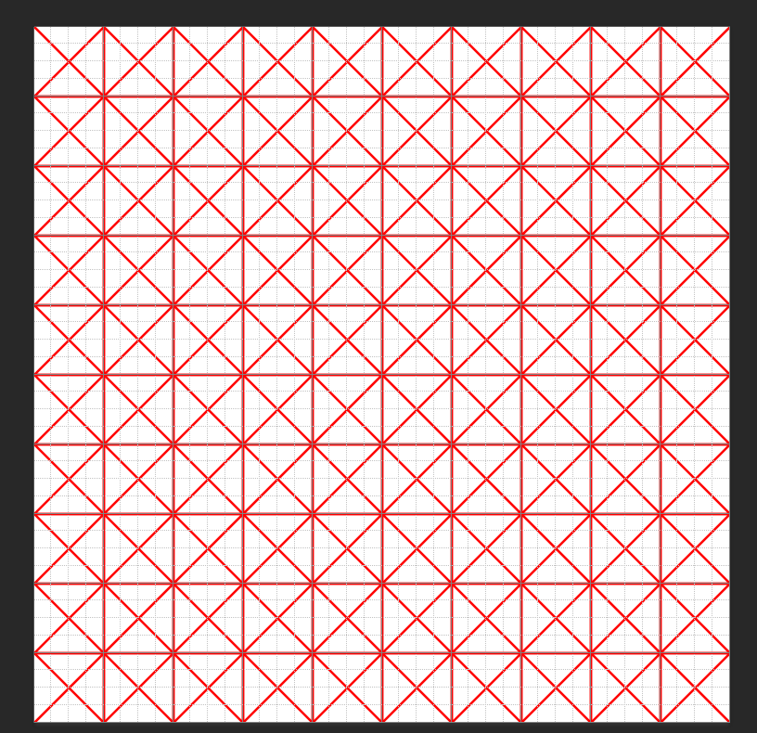
Example 3
Finish with your lines
Complete one half, duplicate the layer
Change the angle to 180
Merge layer 1 copy and layer 1
Duplicate layer 1
Change the angle of layer 1 copy to 90
Save this and upload to Op Art– Example 3 in Google Classroom

Slide 23
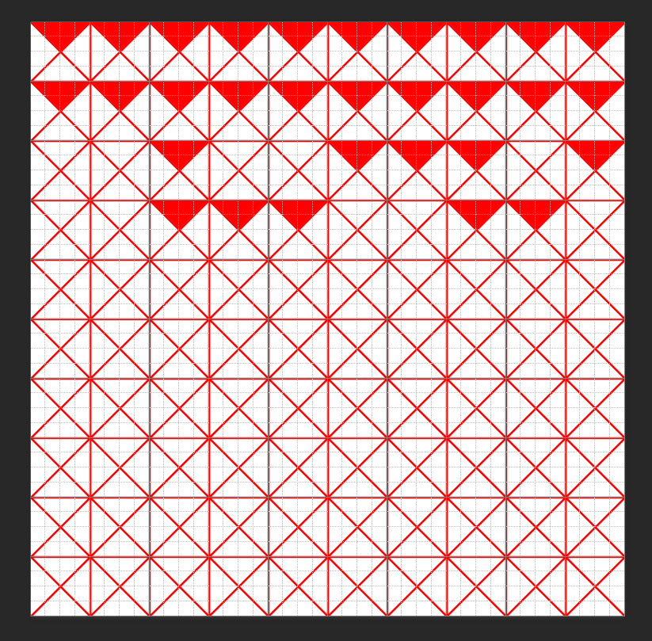
Example 3
Merge layer 1 copy and layer 1
Add a blank layer between the background and layer 1
Start coloring pieces in
The top of the “X” should be the same everywhere

Slide 24
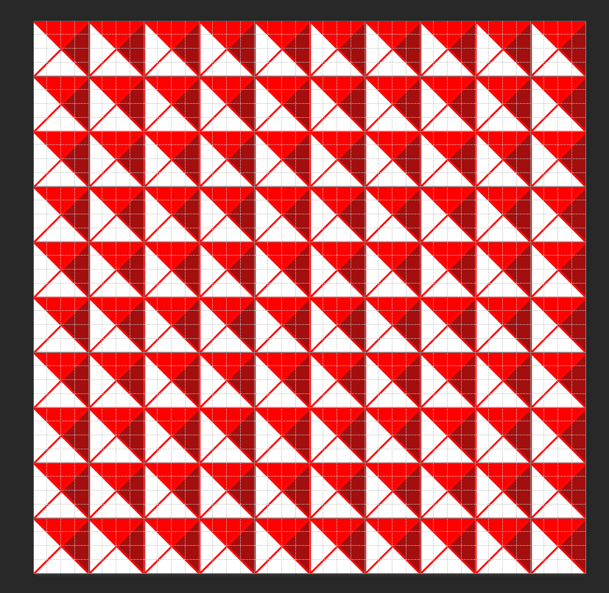
Example 3
Finish with your first color, then make your color slightly darker and do a second side (left or right

Slide 25
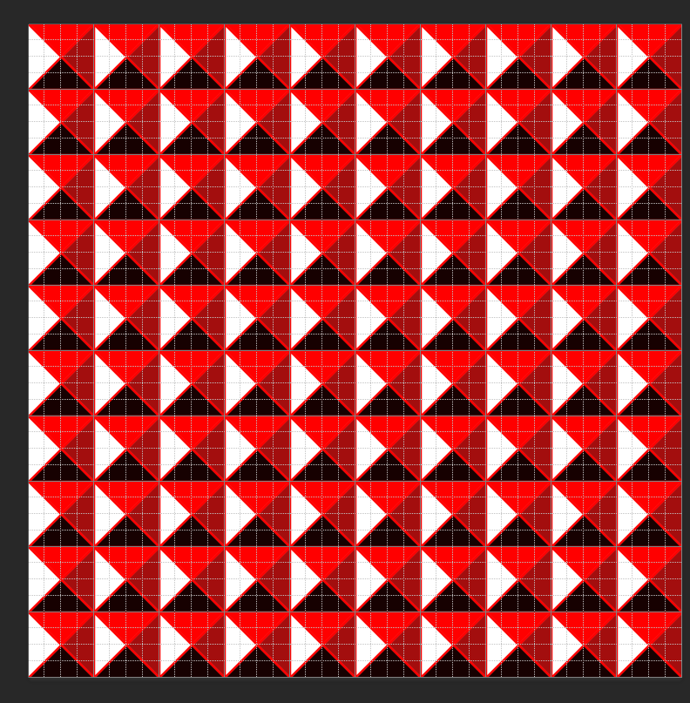
Example 3
Do your third side in a dark color
You can leave one of the 4 sides white, or color it in
This could be a background to combine with another illusion

Slide 26
Example 4
Create a new document
10x10x300
This time we need the ellipse tool
At the top, change the setting to pixels
Towards the right, click the wheel and select:
Circle
From center

Slide 27
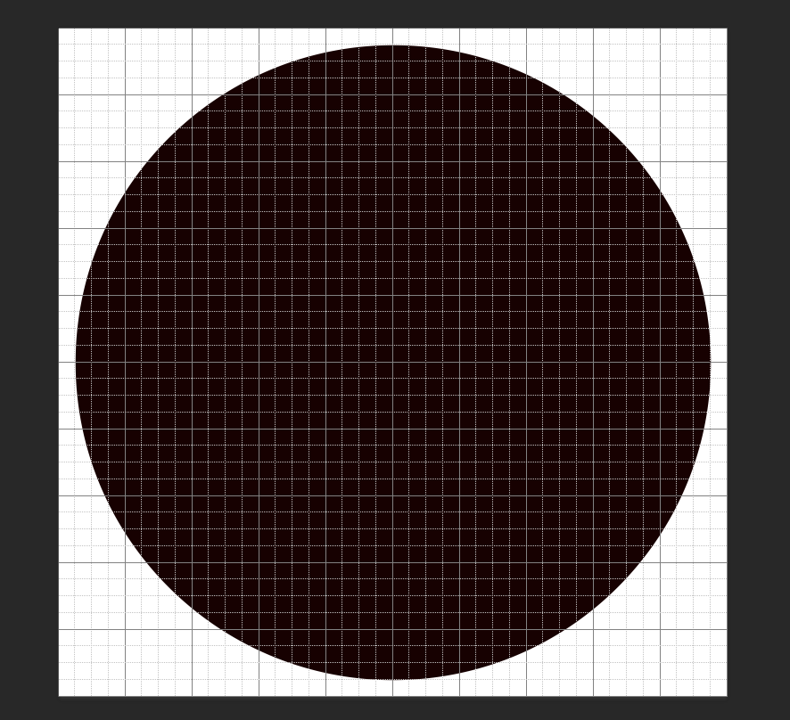
Example 4
Make a new layer
Create your circle
It should be black
Do not make it touch the edges, but go ALMOST to the edges

Slide 28
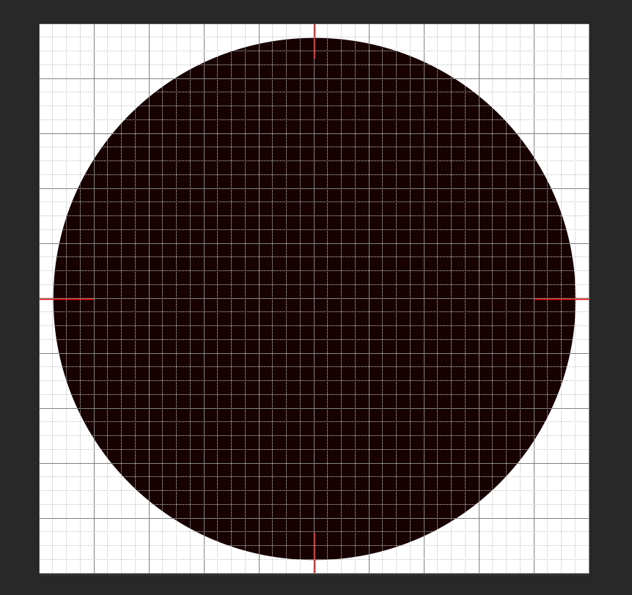
Example 4
Make another new layer
Go back to the line tool
Pixels
Use red or white
Make a mark at the middle of all 4 sides

Slide 29
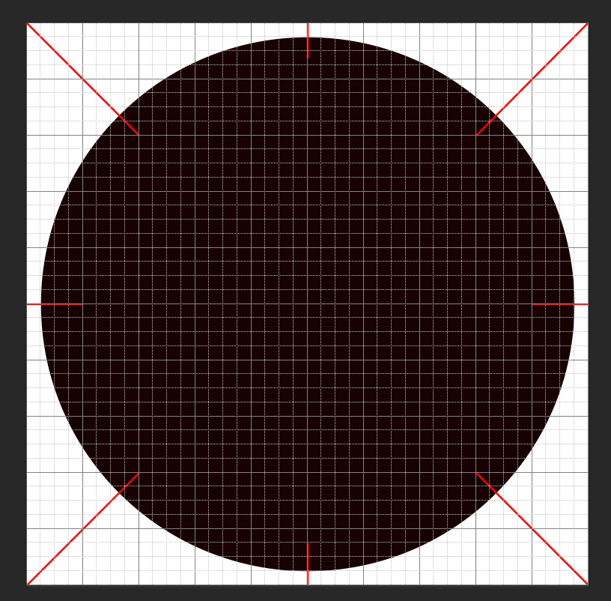
Example 4
Make marks from the corners to just inside the circle

Slide 30
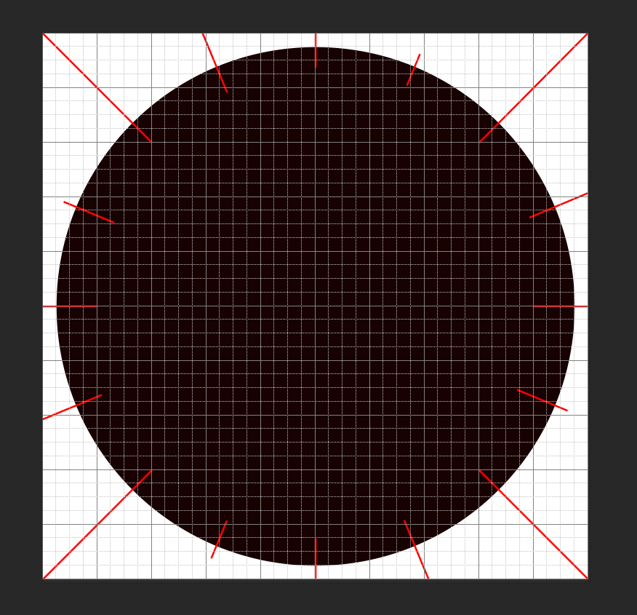
Example 4
Duplicate layer 2
Hit control T
Change the angle to 22.5
If you want, you can merge layer 2 copy & layer 2
Then duplicate the layer, and hit control T
Change the angle to 11.25
This will give you double the number of marks

Slide 31
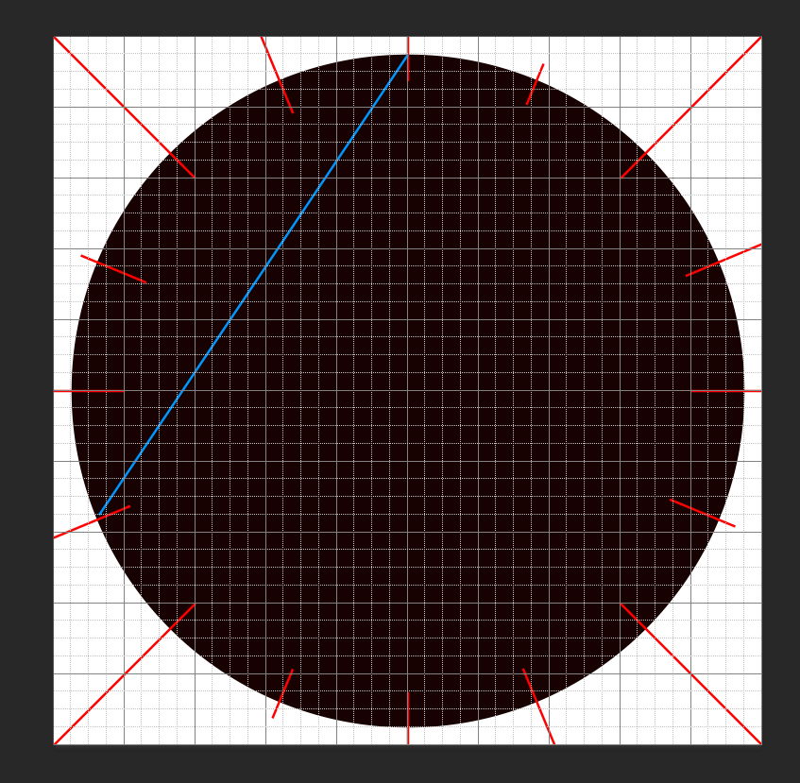
Example 4
If you left the angle at 22.5…
Merge layer 2 copy and layer 2
Make a new layer
Change your line color to something else
Starting at the top, make a mark to 5 apart to the left

Slide 32
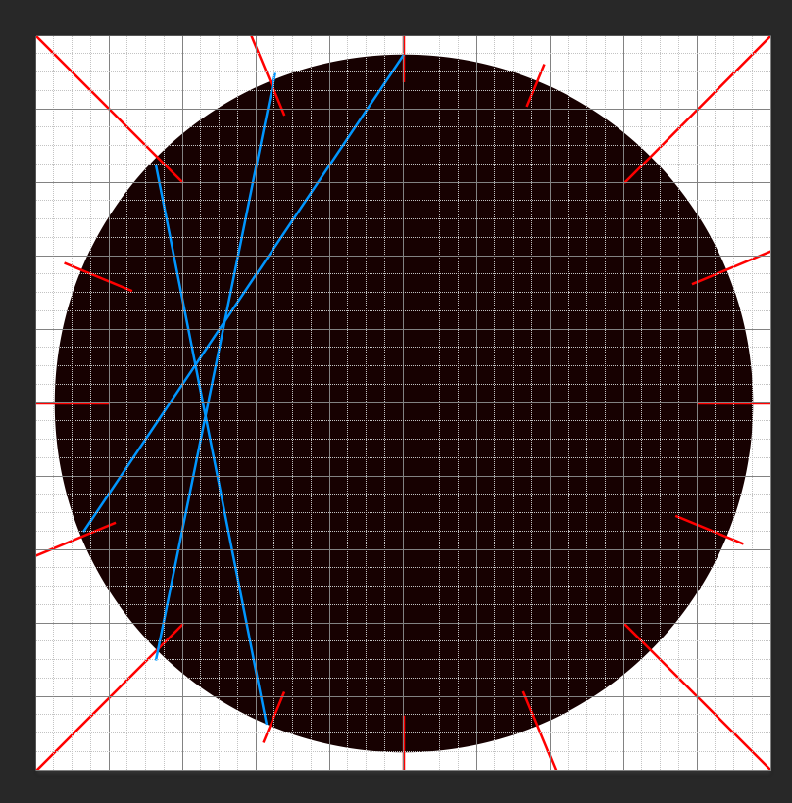
Example 4
Continue to the next red mark to 5 apart again
Finish all around the circle

Slide 33
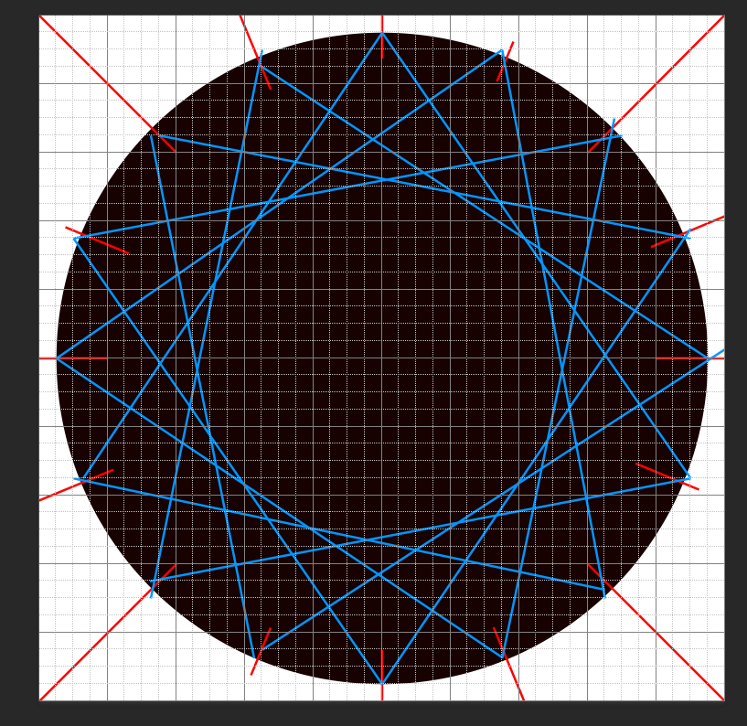
Example 4
Continue all around the circle
Each red line should have 2 blue lines coming from it
Save this and upload to Google Classroom Op Art– Example 4

Slide 34
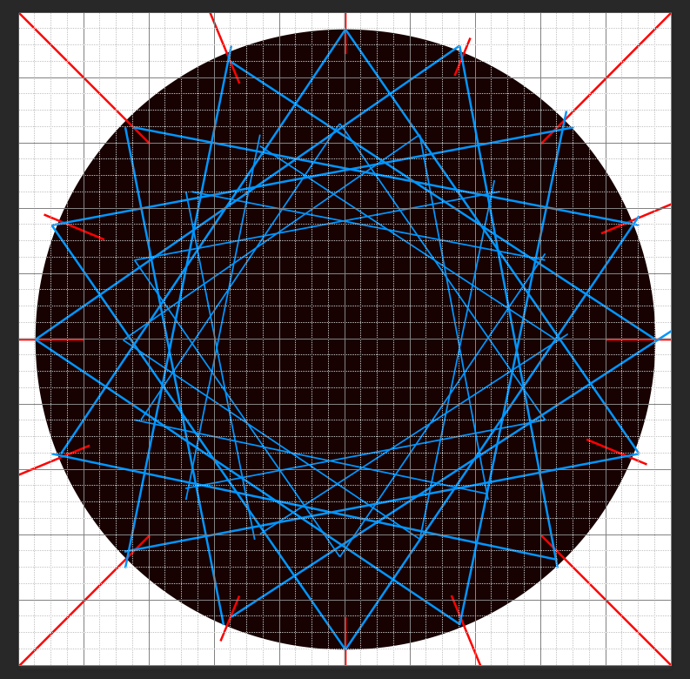
Example 4
You can duplicate layer 3 and make it smaller to fill up the circle
(Duplicate layer 3, hit control t)
(When dragging the corner to make smaller, hold shift down so the proportions remain the same)
Move to the center

Slide 35
Example 5
Create a new document
10x10 inches x 300
Create a new layer
Use the line tool, make sure it is set to pixels

Slide 36
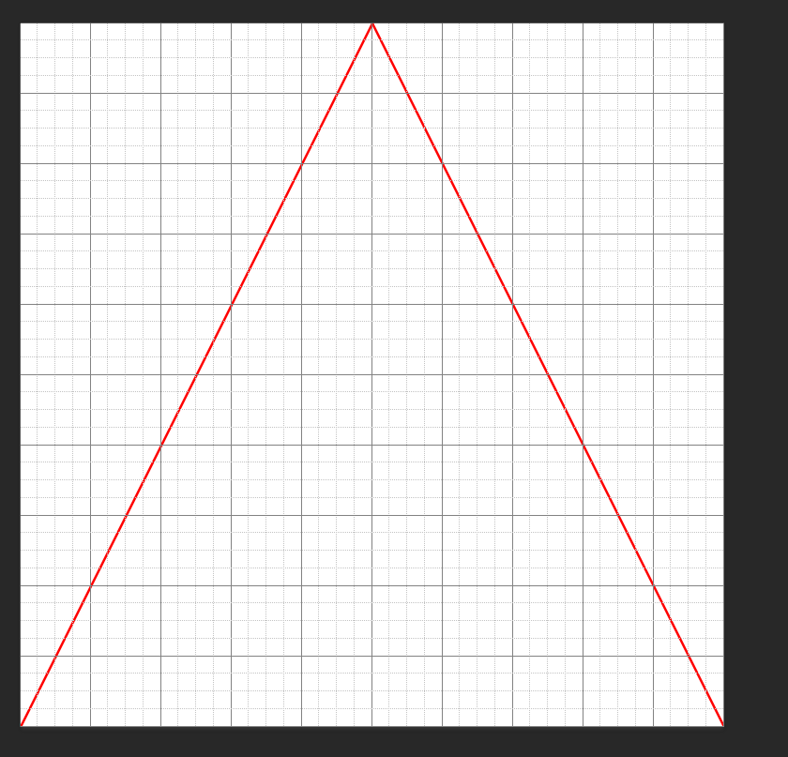
Create a line from the center line at the top to the corners at the bottom

Slide 37
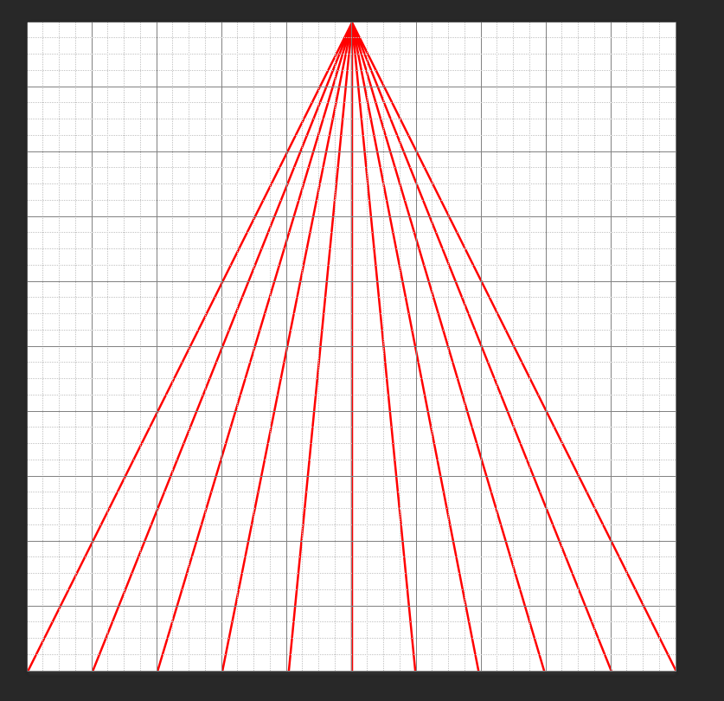
Example 5
Continue connecting the top middle to the main lines at the bottom

Slide 38
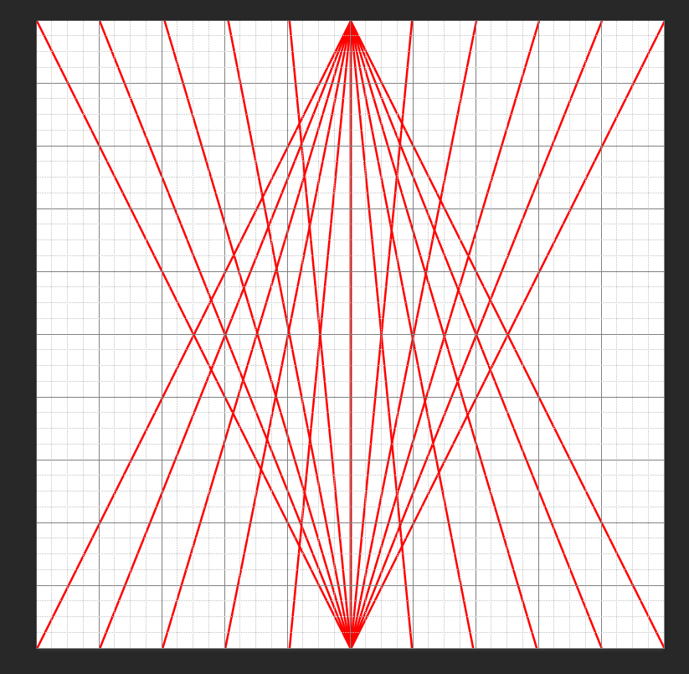
Example 5
Duplicate layer 1
Hit control T to transform
Change the angle to 180
Merge layer 1 copy and layer 1

Slide 39
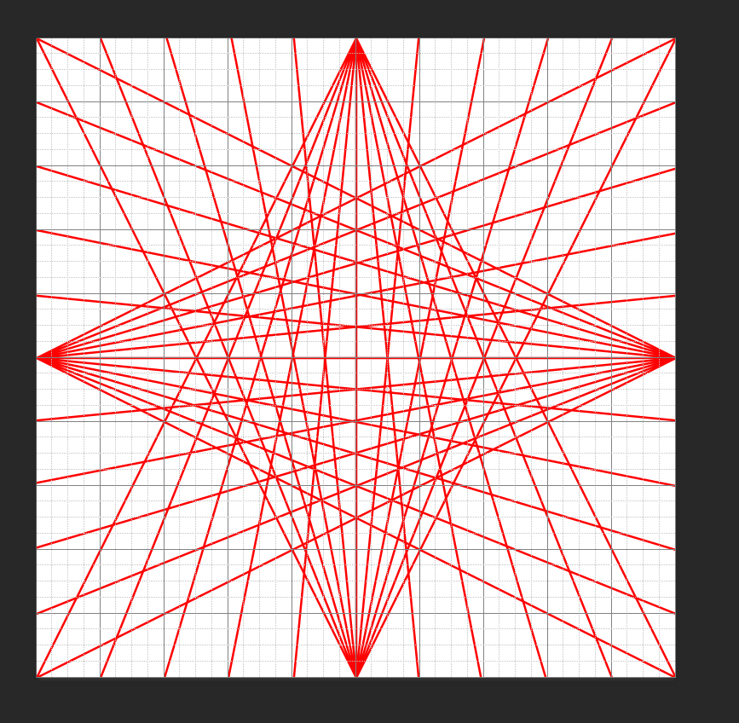
Example 5
Duplicate layer 1
Hit control T to transform
Change the angle to 90
Save this part and upload to example 5 in google classroom

Slide 40
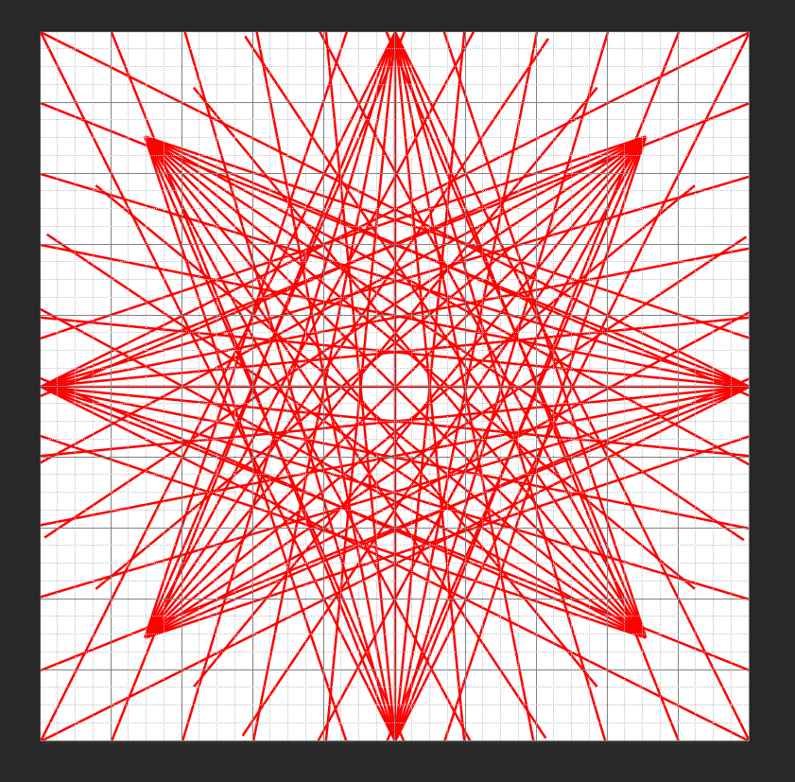
Example 5
Merge layer 1 copy & layer 1
Duplicate layer 1 (after merged)
Hit control T to transform
Change the angle to 45

Slide 41
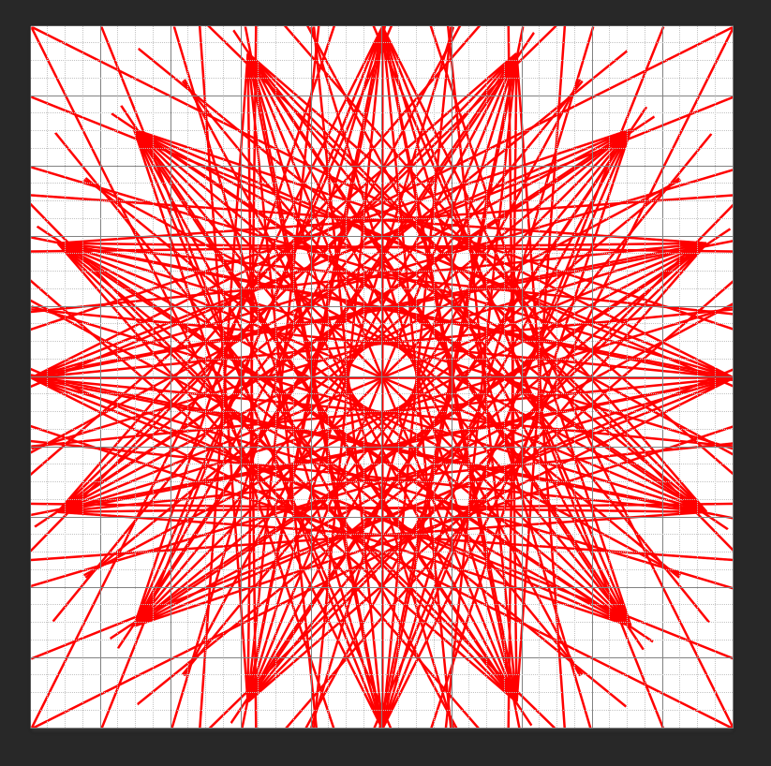
Example 5
Merge layer 1 copy and layer 1 again
Duplicate the new layer 1
Hit control T and change the angle to 22.5

Slide 42
Finishing/making your own illusion
The more you merge & then duplicate layers & change the angle, the more complex your illusion will become
Remember to have angles going in half—
180, 90, 45, 22.5, 11.25 etc
You can also duplicate layers without merging fist to give a different effect
Still transform the angles at 180, 90, 45, 22.5, 11.25, etc
If you combine several of these illusions together you can create more complex illusions
You can also color in pieces
Can you create other illusions?

